Slide 1
"Digital Media Primer" Yue-Ling Wong,
Copyright (c)2013 by Pearson Education, Inc. All rights reserved.

Slide 2
Chapter 2
Fundamentals of Digital Imaging
Part 1
Digitizing Images

Slide 3
In this lecture, you will find answers to these questions
What does digitizing images mean?
How are images sampled and quantized in the digitization process?
How are pixels, image resolution, and bit depth related to sampling and quantizing?
How do the choices of the sampling rate and bit depth affect the image fidelity and details?

Slide 4
Recall: Digitization
To convert analog information into digital data that computers can handle
2-step process:
  sampling
  quantization

Slide 5
Pegboard Analogy

Slide 6

Pegboard Analogy
A 10 holes ×10 holes pegboard

Slide 7

Pegboard Analogy
Suppose you want to copy this music not graphic on the pegboard.

Slide 8

Pegboard Analogy
Place one peg.

Slide 9

Pegboard Analogy
2 pegs.

Slide 10

Pegboard Analogy
3 pegs.

Slide 11

Pegboard Analogy
Suppose we only put peg in a hole if more than half of its area is covered by the musical note graphic.

Slide 12
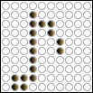
Pegboard Analogy
Now remove the musical note overlay.

Slide 13
Pegboard Analogy
Details are lost because the grid
is too coarse for this musical note.

Slide 14
How would you improve the details of the musical notes on the pegboard?

Slide 15

Using a pegboard with more holes

Slide 16

Using a pegboard with more holes
Now it looks closer to the original musical note.

Slide 17
Pixels
Each peg hole on the pegboard is a sample point.
The sample points are discrete.
In digital imaging, each of these discrete sample points is called a picture element, or pixel for short.

Slide 18
Pixel Dimensions
Refer to an image’s width and height in pixels
In the pegboard analogy, the dimension of this pegboard would be 10 holes × 10 holes.

Slide 19

Sampling Step

Slide 20
Let's look at the sampling step of digitizing a natural scene as if we are taking a digital photo of a natural scene.

Slide 21
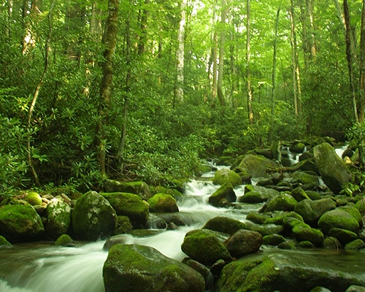
A natural scene
Look up and let your eyes fall on the scene in front of you. Draw an
imaginary rectangle around what you see. This is your “viewfinder.”
Imagine that you are going to capture this view on a pegboard.

Slide 22
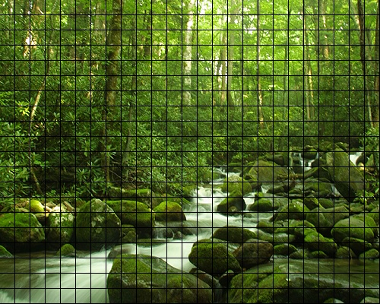
Sample into a grid of 25 × 20 discrete samples
Suppose you are going to sample the scene you see in the "viewfinder" into a pegboard with 25 × 20 holes.

Slide 23

One color for each peg hole.
Each peg hole takes only one peg. Suppose each peg has one solid color. Suppose the color of each of these discrete samples is determined by averaging the corresponding area.

Slide 24
This sampled image looks blocky. Details are lost because the grid is too coarse for this image.

Slide 25
For 25 × 20 sample points, it means you get a digitized image of 25 × 20 pixels.

Slide 26
Let's try a different grid size.

Slide 27
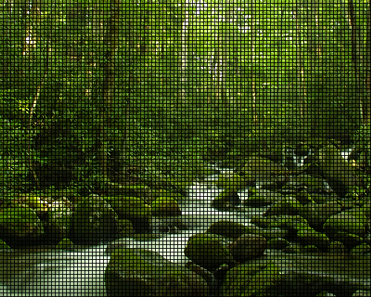
Sample into a grid of 100 × 80 discrete samples
Suppose you are going to sample the scene you see in the "viewfinder" into a pegboard with 100 × 80 holes.

Slide 28

Again, one color for each peg hole.

Slide 29

For 100 × 80 sample points, it means you get a digitized image of 100 × 80 pixels.

Slide 30
Sampling Rate
Refers to how frequent you take a sample
For an image, sampling frequency refers to how close neighboring samples are in a 2-D image plane.

Slide 31
Sampling Rate
For example, when we change the grid from 25 × 20 to 100 × 80, we say that we increase the sampling rate.
  You are sampling more frequently within the same spatial distance.

Slide 32
Resolution
In digital imaging, increasing the sampling rate is equivalent to increasing the image resolution.

Slide 33
Consequences of Higher Resolution
With higher resolution,
You have more sample points (pixels) to represent the same scene, i.e., the pixel dimensions of the captured image are increased.
The file size of the digitized image is larger.
You gain more detail from the original scene.

Slide 34
Resolution of Digital Photos
Note that 25 × 20 and 100 × 80 pixels are by no means realistic pixel dimensions in digital photography.
They are only for illustration purposes here. Most digital cameras can capture images in the range of thousand pixels in each dimension—for example, 3000 pixels × 2000 pixels.

Slide 35
A Pixel is not a Square Block
A pixel is a sample point.
It does not really have a physical dimension associated with it.

Slide 36
A Pixel is not a Square Block
When you zoom in on a digital image in an image editing program, you often see the pixels represented as little square blocks.
This is simply an on-screen representation of a sample point of an digitized image.

Slide 37
Colors

Slide 38
Problems
A natural image is colored in continuous tones, and thus it theoretically has an infinite number of colors.
The discrete and finite language of the computer restricts the reproduction of an infinite number of colors and shades.

Slide 39
Quantization Step
To encode an infinite number of colors and shades with a finite list.
Quantizing the sampled image involves mapping the color of each pixel to a discrete and precise value.

Slide 40
Quantization Step
First, you need to consider how many possible colors you want to use in the image.
To illustrate this process, let’s return to the example of the 100 × 80 sampled image.

Slide 41
The sampled 100 × 80 image

Slide 42
Say, we want to map the color of each sample points into one of these four colors:

Slide 43

Quantized with 4 Colors

Slide 44

Quantized with 8 Colors

Slide 45
Consequences of Quantization
Reduce the number of allowed colors in the image.
When we reduce the colors, different colors from the original may bemapped to the same color on the palette. This causes the loss of the image fidelity and details.
The details that rely on the subtle color differences are lost during quantization.

Slide 46
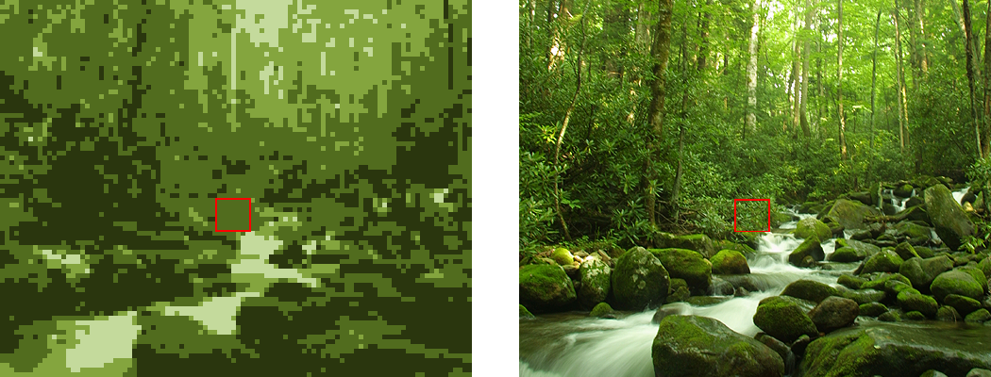
The same area in the 4-color image now has only one color.
The area outlined in red is made up of many different green colors.

Slide 47
Bit Depth
The number of colors used for quantization is related to the color depth or bit depth of the digital image.
A bit depth of n allows 2^{n} different colors. Examples:
  A 2-bit digital image allows 2² (i.e., 4) colors in the image.
  An 8-bit digital image allows 2⁸ (i.e., 256) colors in the image.
The most common bit depth is 24. A 24-bit image allows 2²⁴ (i.e., 16,777,216) colors.

Slide 48
Will increasing the number of colors in the palette improve the image fidelity?
It depends, and in most cases, can be yes.
The number of colors or the bit depth is not the only determining factor for image fidelity in quantizing an image.
The choice of colors for the quantization also plays an important role in the reproduction of an image.

Slide 49

Quantized with 8 Different Colors

Slide 50
Effect of Bit Depth on File Size
Higher bit depth means more bits to represent a color.
Thus, an image with a higher bit depth has a larger file size than the same image with a lower bit depth.

Slide 51
Review Questions
Note to instructor:
Depending on your preference, you may want to go over the review questions at the end of this lecture as an instant review or at the beginning of next lecture to refresh students' memory of this lecture.

Slide 52
Review Question
Recall that the process of converting from analog to digital information is a 2-step process--sampling and quantizing. In capturing an analog image to a digital image, the sampling rate affects ___.
A. the bit depth of the resulting digital image
B. the pixel dimensions of the resulting digital image
Notes:
B

Slide 53
Review Question
In the quantization step, to capture an analog image to a digital image, ___.
A. a 2-dimensional grid is applied on the image and each tiny cell on the grid is converted into a pixel
B. a 2-dimensional grid is applied on the image to apply dithering to the image
C. an infinite number of color shades and tones in an analog image is mapped to a set of discrete color values
D. the resulting digital image file is compressed to have a smaller file size
Notes:
C

Slide 54
Review Question
Which of the following factors will increase the file size of a digital image?
A. larger pixel dimensions of the image
B. higher color depth
Notes:
both A and B

Slide 55
Review Question
A digital image captured at a higher resolution ___.
A. captures more details than the same image stored at a lower resolution
B. represents more colors than the same image stored at a lower resolution
C. has greater bit depth than the same image stored at a lower resolution
D. has a larger file size than the same image stored at a lower resolution
E. has larger pixel dimension than the same image stored at a lower resolution
Notes:
A, D, and E

Slide 56
Review Question
If a digital image captured at a higher resolution, ___than it would have been captured at a lower resolution.
A. it has larger pixel dimensions
B. it has a higher bit depth
C. it has more different colors
D. it has a larger file size
E. the sampling step uses a higher sampling rate
Notes:
A, D, and E

Slide 57
Review Question
If a digital image has a higher bit depth, ___than it would have been at a lower bit depth.
A. it has larger pixel dimensions
B. it has more different colors
C. it has a larger file size
D. a higher sampling rate is used
Notes:
B and C

Slide 58
Review Question
The term “pixel” is contracted from the words ___ ___.
Notes:
picture element

Slide 59
Review Question
True/False: A pixel is a point sample, not a little square.
Notes:
true

Slide 60
Review Question
True/False: An 1-bit color depth allows only 2 colors.
Notes:
true

Slide 61
Review Question
True/False: An 1-bit color depth allows only black and white colors.
Notes:
false

Slide 62
Review Question
An 8-bit color depth allows ___ colors,
Notes:
2⁸ = 256

Slide 63
Review Question
An 24-bit color depth allows ___ colors,
Notes:
2²⁴

